Slide 1
Warehouse Management
202012053 – Chandni Asnani
202012054 – Pradeep Sindham
202012055 – Harshil Patel
202012056 – Alkesh Kataria
202018027 – Nisarg Thakkar
202018028 – Shreya Patel

Slide 2
Functional Requirements
There are many warehouses in many cities.
There are many suppliers supplying items to the warehouses.
An item can be supplied by many suppliers to different warehouses.
A customer can order different items of different quantities.
Payment can be made by either cash or online.
Employees work at a particular warehouse, they can be either a worker, manager, driver etc.
The delivery of an order is done by vehicles.

Slide 3
ER
\Lab_202012053-202012054-202012055-202012056-202018027-202018028 _ER_V5.pdf

Slide 4
Relational model
Lab_202012053-202012054-202012055-202012056-202018027-202018028_Requirements_V5.pdf

Slide 5
DDL Statements
Item
create table item(
itemid char(10) PRIMARY KEY,
Categoryid char(10),
name varchar(20) not null,
cost integer ,
foreign key (Categoryid) REFERENCES itemcategory(Categoryid) )
Orders
create table orders(
orderId char(10) PRIMARY KEY,
transportId char(10),
customerid char(10),
order_Placed_date date,
order_delivery_date date,
foreign key (transportId) REFERENCES transport(transportId),
foreign key (customerid) REFERENCES customer(customerid) )
Supplier
create table supplier (
supplierID char(10) PRIMARY KEY,
name varchar(50) not null,
contact char(10) unique not null,
Address Text,
CONSTRAINT contact CHECK (contact not like '%[^0-9]%') );
Order Contains
create table ordercontains(
orderid char(10) REFERENCES orders(orderid) not null unique ON DELETE RESTRICT,
itemid char(10) REFERENCES item(itemid) not null unique ON UPDATE RESTRICT,
Quantity integer, PRIMARY KEY (orderid,itemid) )
Supplied by
create table suppliedby(
supplierID char(10) REFERENCES supplier(supplierID),
itemid char(10) REFERENCES ordercontains(itemid) not null ON UPDATE CASCADE ,
orderid char(10) REFERENCES ordercontains(orderid) not null ON DELETE RESTRICT,
PRIMARY KEY (itemid,orderid)
)

Slide 6
DDL Statements (Contd.)
Warehouse
create table warehouse(
warehouseid char(10) PRIMARY KEY,
managerid char(10),
cityid char(10) ,
name char(30) not null,
Total_Capacity numeric,
usedcapacity numeric,
foreign key (cityid) REFERENCES city(cityid)
)
Stock
create table stock(
itemid char(10) references item(itemid) ON UPDATE CASCADE,
warehouseid char(10) REFERENCES warehouse(warehouseid),
supplierID char(10) REFERENCES supplier(supplierID),
quantity integer ,
PRIMARY KEY (itemid,warehouseid,supplierID)
)

Slide 7
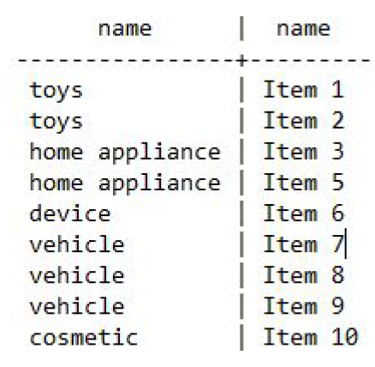
Get the most popular item from each category
select ic2.name,i2.name from itemCategory ic2
join item i2 on i2.itemCategoryID = ic2.itemCategoryID
join (
select tmp.ici ici ,max(cnt) mx from (
select i.itemCategoryID ici,i.itemID ii,count(oc.quantity) cnt from
item i
join orderContains oc on oc.itemID = i.itemID
group by i.itemCategoryID,i.itemID
) tmp
group by tmp.ici
) tmp2
on ic2.itemCategoryID = tmp2.ici
where tmp2.mx = (select count(*) from orderContains where itemID =
i2.itemID);
Note : It has many items of same category having same level of popularity.

Slide 8
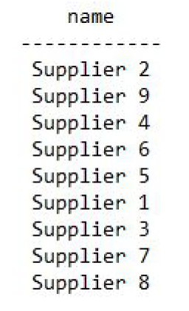
List suppliers in order of their popularity
select (select name from supplier where supplierID = s.supplierID) as name from
supplier s
join suppliedBy sb on sb.supplierID = s.supplierID
join orderContains oc on (oc.orderID=sb.orderID and oc.itemID=sb.itemID)
group by s.supplierID
order by sum(oc.quantity) desc;

Slide 9
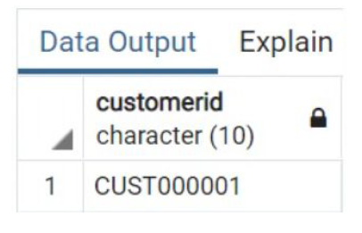
List all customer who ordered all the items
select customerid from orders
except
(
select customerid from
(
select o.customerid, items.itemid from orders as o
join ordercontains as oc
on oc.orderid=o.orderid
cross join
(select * from item) as items
except
select customerid, itemid from orders as o join ordercontains as oc on
oc.orderid=o.orderid
) as r2
)

Slide 10
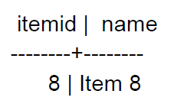
List items that are available at all warehouses
select i.itemID, i.name from item i
where i.itemID not in (
select distinct tmp.itemID from (
select i2.itemID,w.warehouseID from warehouse w,item i2
except
select distinct itemID,warehouseID from stock
) tmp
);

Slide 11
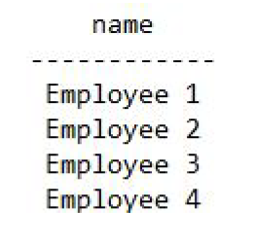
List drivers ordered by their 'Bang for Buck'
select
(select name from employee where employeeID=e.employeeID)
as name from
employee e
join transport t on t.employeeID = e.employeeID
group by e.employeeID,e.salary
order by (e.salary/count(*))

Slide 12
Concluding remarks
we all have learned a lot by building this DB, and could have learned a lot more if we had time to build a driver program with the help of JDBC and some rudimentary cli interface.

Slide 13
THANKYOU

